Slide 1

NASI SPONSORZY I PARTNERZY

Slide 2
Enterprise Audit Trail Case Study and Notes from the Field
Andrzej Kukuła
LGBS Software sp. z o.o.
andrzej.kukula@gmail.com

Slide 3
Key deliverables
Know what audit trail is
Get acquainted with enterprise audit requirements and architectures
Know available technologies
Be able to implement some scenarios
Be aware of limitations

Slide 4
Introduction
Is this session about SQL Server at all?
You guess it ☺
Is this just about triggers?
NO, not going to be so simple
YES, triggers are also mentioned

Slide 5
Case Study
The requirement was to implement technical audit trail for a global company, on selected SQL Servers
It wasn’t allowed to use commercial tools
All instances were SQL Server 2012 Enterprise Edition
☺
We will refer to the actual production implementation

Slide 6
Why audit at all?
We may be obliged by outside regulations
HIPAA, SOX, PCI, GLBA, FERPA, FDA, Sarbanes-Oxley, EU Data Protection Directive (95/46/EC)
Internal requirements
Temporary needs - we know that „something is happening” in our database, and just want to track down exact activity

Slide 7
Introduction to Audit Trail
a.k.a. Audit Log
A record, or set of records
Documents sequence of activities (events) in a system
Chronological, time-bound
Not alterable (append-only)
Not readable for ordinary user (secure)
Integrated into the system

Slide 8
Introduction to Audit Trail
Example events
Database access – successful and failed logins
Data access – attempts to get data out of database
Data manipulation – inserts, updates, deletes
Object change – such as adding or dropping a column
Permission change – granting (un)authorized access to data
Ownership change – another form of giving access to data

Slide 9
Audit Trail properties
Allows to identify
Principal that caused the event (who)
Place where it was introduced (where)
Time it occurred (when)
The way event occurred (how)
The change itself (modified data or objects) (what)
Performance requirements
Audit log should be gathered with minimum impact on live database, no unnecessary locking, no MSDTC involved
Security requirements
Audit feature itself and audit data must be protected (there may be sensitive information)

Slide 10
Two kinds of changes
Data changes (DML)
Obvious ways
Insert, update, delete
Not so obvious
Database restore, partition switch, default constraints
Database / server level events
Data access, data modification
Object changes, e.g. permissions, roles, ownerships, names
Change in auditing
Backup/Restore operations

Slide 11
Methods of audit log generation
Manual (application level)
Application writes audit log records when appropriate
Log of transactions
General Ledger, Inventory / stock log, Medical records
Change log and historic data capture
custom solutions
DW-like approaches (e.g. expiration date for data)
Useful in particular scenarios
Extremely flexible
Not very secure (from database perspective)

Slide 12
Methods of audit log generation
Automatic (database level)
More reliable than application-level logging
Will not skip any event
Is unable to be bypassed (if implemented properly)
Secure
Append-only, cannot be altered even by SQL Server administrator (if implemented properly)
By default only dbo / sysadmin / CONTROL SERVER is required to read it

Slide 13
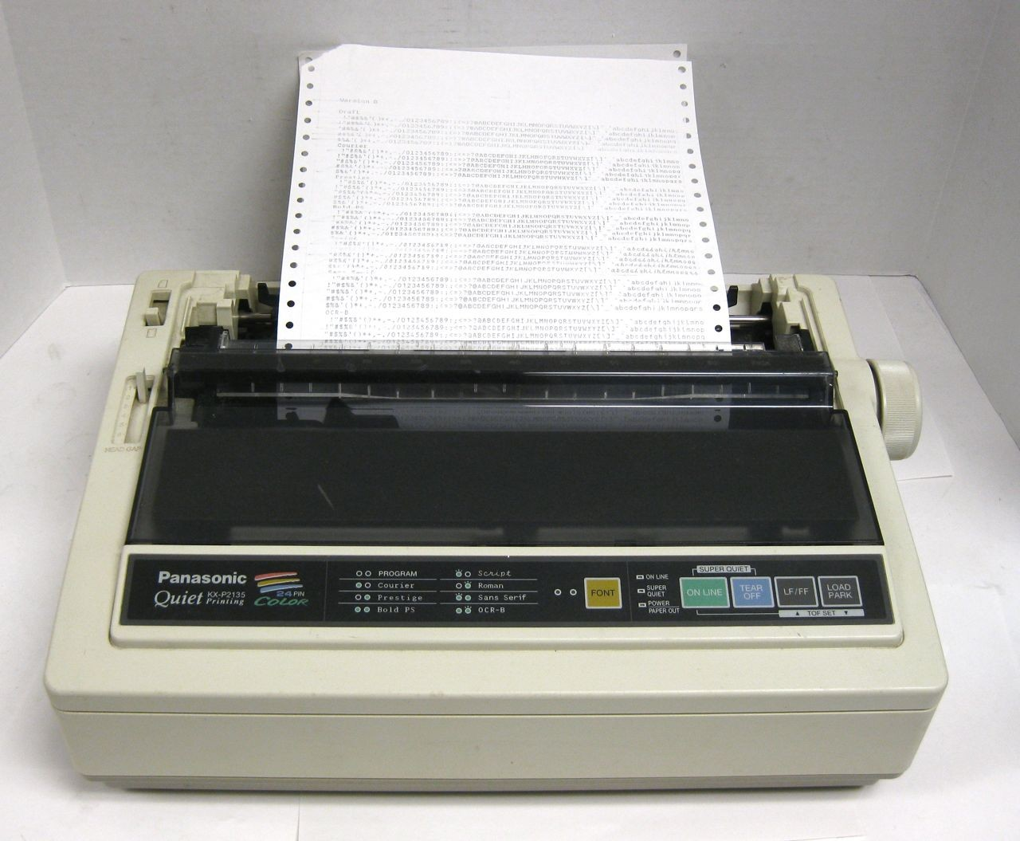
Real life append-only logging example

Slide 14
Dual Layer Enterprise Audit Architecture
Layer 1
Get the audit data ASAP and store it locally
Avoid DTC, reduce latency
Preferably after commit, not during the transaction
One „shadow” table for one audited table
Store historic data in relational way
On separate filegroup if required
Plan carefully, look for FILESTREAMS, FILETABLES, [N]VARCHAR(MAX), VARBINARY(MAX)

Slide 15
Audit Architecture Layer 1

Slide 16
Dual Layer Enterprise Audit Architecture
Layer 2
Get the data from the layer 1 and store it offline
E.g. in enterprise-wide audit data warehouse
Periodic ETL
Separation of sysadmin permissions
Ability to use familiar analytic and reporting tools
Reporting doesn’t cause additional load on production database

Slide 17
Dual Layer Enterprise Audit Architecture

Slide 18
Common Technologies
Custom Trigger-based solution
Change Tracking
Change Data Capture
SQL Trace
Extended Events
Server Audit and Database Audit

Slide 19
Triggers
Probably most often used solution so far
Available in all SQL Server editions
Easy to implement and to understand
Very flexible, allow for full customization, trigger can do whatever is required
A trigger on INSERT, UPDATE, DELETE is required on each interesting table
DDL triggers can watch for object changes
Can include all required auditing information
Many commercially available tools base on triggers

Slide 20
Triggers
Drawbacks
Performance overhead (audit logging happens during the DML transaction, so rollbacks have additional cost)
Can impact application (will rollback transaction if logging doesn’t succeed…)
Usual concurrency / locking issues
May interfere with other triggers and potentially cause data consistency issues (@@IDENTITY)
Difficult to maintain securely (create or alter trigger requires just an ALTER permission on an underlying table)
Not used in our implementation

Slide 21
SQL Server Change Tracking
Available in SQL Server 2008 or later, any edition
Captures the fact that data has changed, but not the data itself
Doesn’t include auditing information (when, who, and where)
Tracked table must have PK
Not designed as an auditing tool
Best for synchronizing sporadically connected clients, or for incremental ETL
Not used in our implementation

Slide 22
SQL Server Change Data Capture
Available in SQL Server 2008 and later, Enterprise Edition only
Tool to track data changes by DML (INSERT, UPDATE, DELETE)
Captures the fact that data was changed, and current values
Must be enabled separately for each table that needs auditing
Designed to have very low performance impact on database
Suitable for number of purposes, e.g. logging data changes, data archiving, and incremental ETL
Compatible with HA solutions

Slide 23
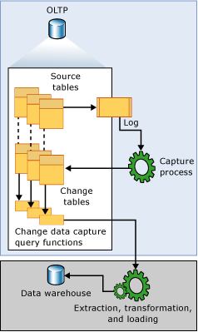
CDC Architecture
Transaction log is read asynchronously (sp_replcmds)
Change data is gathered after transaction commit
Separate „change table” for each tracked table
Change tables are in cdc schema (separation of permissions)
Separation of I/O (change table can be in different filegroup)
Pic from http://msdn.microsoft.com/en-us/library/cc645937(v=sql.120).aspx

Slide 24
CDC Privilege separation
Independent from ALTER TABLE permissions:
Only db_owner can enable/disable CDC
gated role membership required to read CDC data
(or individually assigned SELECT permissions)
EXEC sys.sp_cdc_enable_table 'Sales', 'CurrencyRate',
@role_name='CDCDataReaders';

Slide 25
SQL Server Change Data Capture
Additional issues with CDC
Requires SQL Agent for capture and cleanup jobs
Data includes only LSN number, no user name, workstation name or statement
Care needed when restoring database (KEEP_CDC option is required)
Additional administrative actions required with HA (to create jobs after failover on new primary)
SQL Server or SQL Agent cannot run under NETWORK SERVICE account (http://technet.microsoft.com/en-us/library/cc645937.aspx)
Used in our implementation

Slide 26
SQL Server Change Data Capture
Demo

Slide 27
Event logging
Until this slide we accomplished logging of change data
Now it’s time to know who, where and how made the changes

Slide 28
SQL Trace
Available in all SQL Server editions
Older event logging mechanism
Can be used to monitor and capture broad range of events (http://msdn.microsoft.com/en-us/library/ms175481(v=sql.120).aspx)
Can log to a file or SMO
Allows for custom user-defined events
Deprecated
(http://msdn.microsoft.com/en-us/library/ms173875(v=sql.120).aspx)
Not as efficient as newer tracing technologies (XE)
Not used in our implementation
Default trace can be useful - demo

Slide 29
Extended Events
Available in SQL Server 2008 or newer, all editions
Powerful, modern event-handling infrastructure for SQL Server
Lightweight, very flexible
Allows for insight into any activity inside SQL Server relational engine
Large choice of events and event targets, sophisticated, detailed configuration
Not used in our implementation

Slide 30
SQL Server Audit
Available in SQL Server 2008 and later, all editions (granular database events in Enterprise Edition only)
Several levels of auditing, depending on organization’s internal requirements or authorities-imposed requirements
Based on efficient Extended Events architecture
Can be set to audit all or specific objects, all or specific users, specific events
Objects created after the audit are automatically audited

Slide 31
SQL Server Audit
Can write audit information to log files or Windows event log
Application event log
Security event log (limited access by default)
Disk file (NTFS permissions should be set so SQL Server service account has append-only access)
Audit-related events are also written to audit log - it’s not possible to disable audit without leaving the mark
Can be configured to shut down SQL if auditing is impossible
Can display log file contents as a relational table
But changed data values are either unavailable at all or available in non-relational way

Slide 32
SQL Server Audit
Extensive selection of events
SELECT, UPDATE, INSERT, DELETE, EXECUTE, RECEIVE, REFERENCES
DATABASE_CHANGE_GROUP, USER_DEFINED_AUDIT_GROUP, AUDIT_CHANGE_GROUP, BACKUP_RESTORE_GROUP, ……
Full list: SQL Server Audit Groups and Actions
Can also log user-defined events (sp_audit_write)
Used in our implementation

Slide 33
SQL Server Audit
Minimum (optimal) NTFS permissions for the log folder
Account name, purpose | Permission scope | Permissions
SQL Server service account Write audit events | This folder only | Create files / write data
 | Files only | Create folders / append data
SQL Server service account Read events (if required) | This folder only | List folder / read data
 | Files only | Generic read (List folder / read data, Read attributes, Read extended attributes, Read permissions)
SQL Agent service account Cleanup old events (if required) | This folder only | List folder / read data, Delete subfolders and files

Slide 34
SQL Server Audit
Demo

Slide 35
Considerations
Retention policy for audit data
Audit data can contain sensitive data! (Same issue with Audit Data Warehouse)
With CDC cleanup happens automatically, SQL Audit not
Schema change (columns added, dropped, altered)
No technology will adapt itself
Truly dynamic solution involves writing a lot of code and storing data in key-value tables:
Database–Schema–Table–Column– Data + Audit info
No JOIN between audit data and CDC data
Only partial support in SSDT for audit, no support for CDC

Slide 36
Last but not least
Questions?

Slide 37


Slide 38


Slide 39

NASI SPONSORZY I PARTNERZY
Organizacja: Polskie Stowarzyszenie Użytkowników SQL Server - PLSSUG

Slide 40
Dziękuję

